Slide 1
ITMD 525- DATA MINING
CLASSIFICATION OF PRODUCTS
Group 12
Sarin v Ravishanker – A20349372
Sharan p Babu – a20356488
Notes:
Product classification is task of automatically predicting the product categories based on description, features of product and other related attributes

Slide 2
Business scenario
Ecommerce companies are selling millions of products worldwide everyday, with several thousand products being added to their product line. Therefore it is important for a company to do a consistent analysis on the performance of their products. However, due to the diversity of the company’s global infrastructure, it is challenging to classify each product appropriately.
Notes:
We take a look at scenarios where product classification is widely used. Read from sled

Slide 3
objective
The objective of this project is to apply classification learning models on Ecommerce products dataset with 93 features for around 28,000 products.

Slide 4
Approach
Cleaning and Pre-Processing of Data
Classified the labels using different classification algorithms
Compared accuracy of the classifiers in Weka and R
Built an Ensemble model to improve classification accuracy

Slide 5
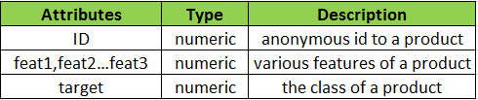
dATASET
Data Source: https://www.kaggle.com/c/otto-group-product-classification-challenge/data
Number of Records: 61,878
93 obfuscated features are provided for the datasets, which represent counts of different events.
The randomly selected products are to be classified into nine categories. Each target category
corresponds to one of the most important product categories (like fashion, electronics, etc.).
Notes:
We chose our dataset from KAGGLE where this was used as part of a product classification challenge.

Slide 6
Data preprocessing
Renamed label attribute to “Category”
Replaced default values of label attribute to meaningful names like fashion, electronics etc.
Notes:
Data was already preprocessed

Slide 7
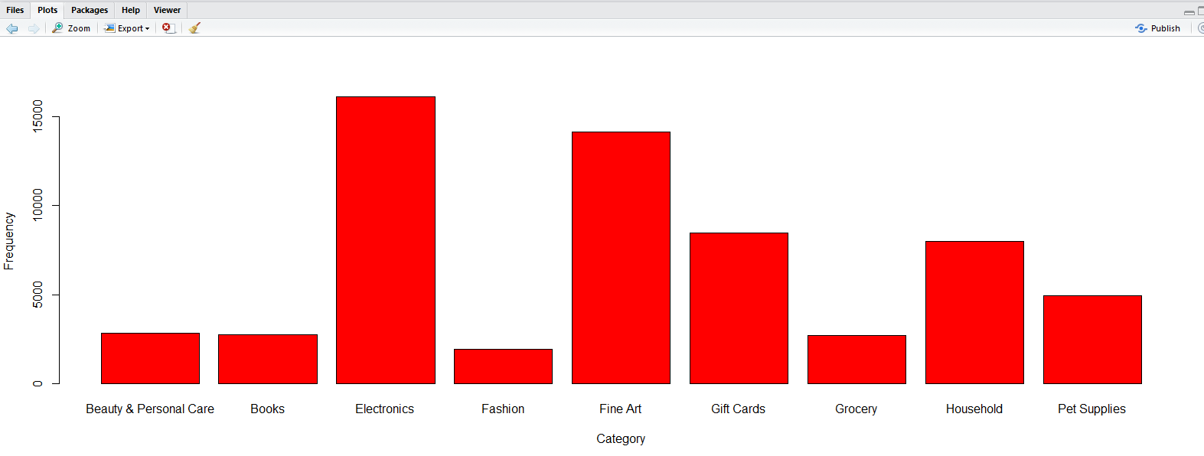
DATA exploration
Fig.1 Distribution of Product Categories
Notes:
Shows how 9 product categories are distributed

Slide 8
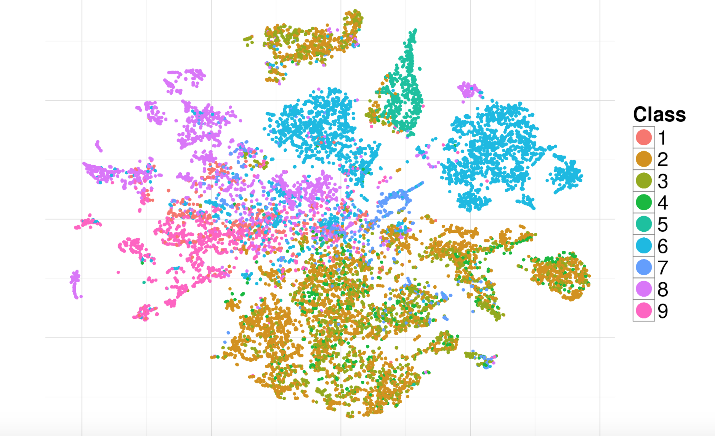
DATA exploration
Distribution of Product Categories

Slide 9
Algorithms used
KNN
Random Forest
XG Boost
ADA Boost
Ensemble Model
* Training data set was split into 60% training data set and 40% as test data

Slide 10
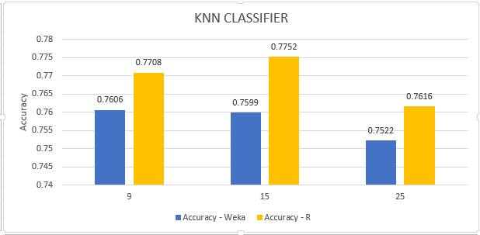
kNN Classifier
Highest Accuracy in WEKA – 0.7606 for K=9
Highest Accuracy in R – 0.7752 for K=15
Fig.2 KNN Classifier Accuracy – R vs Weka

Slide 11
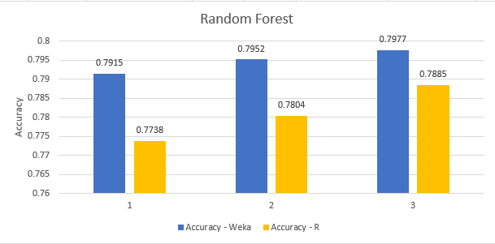
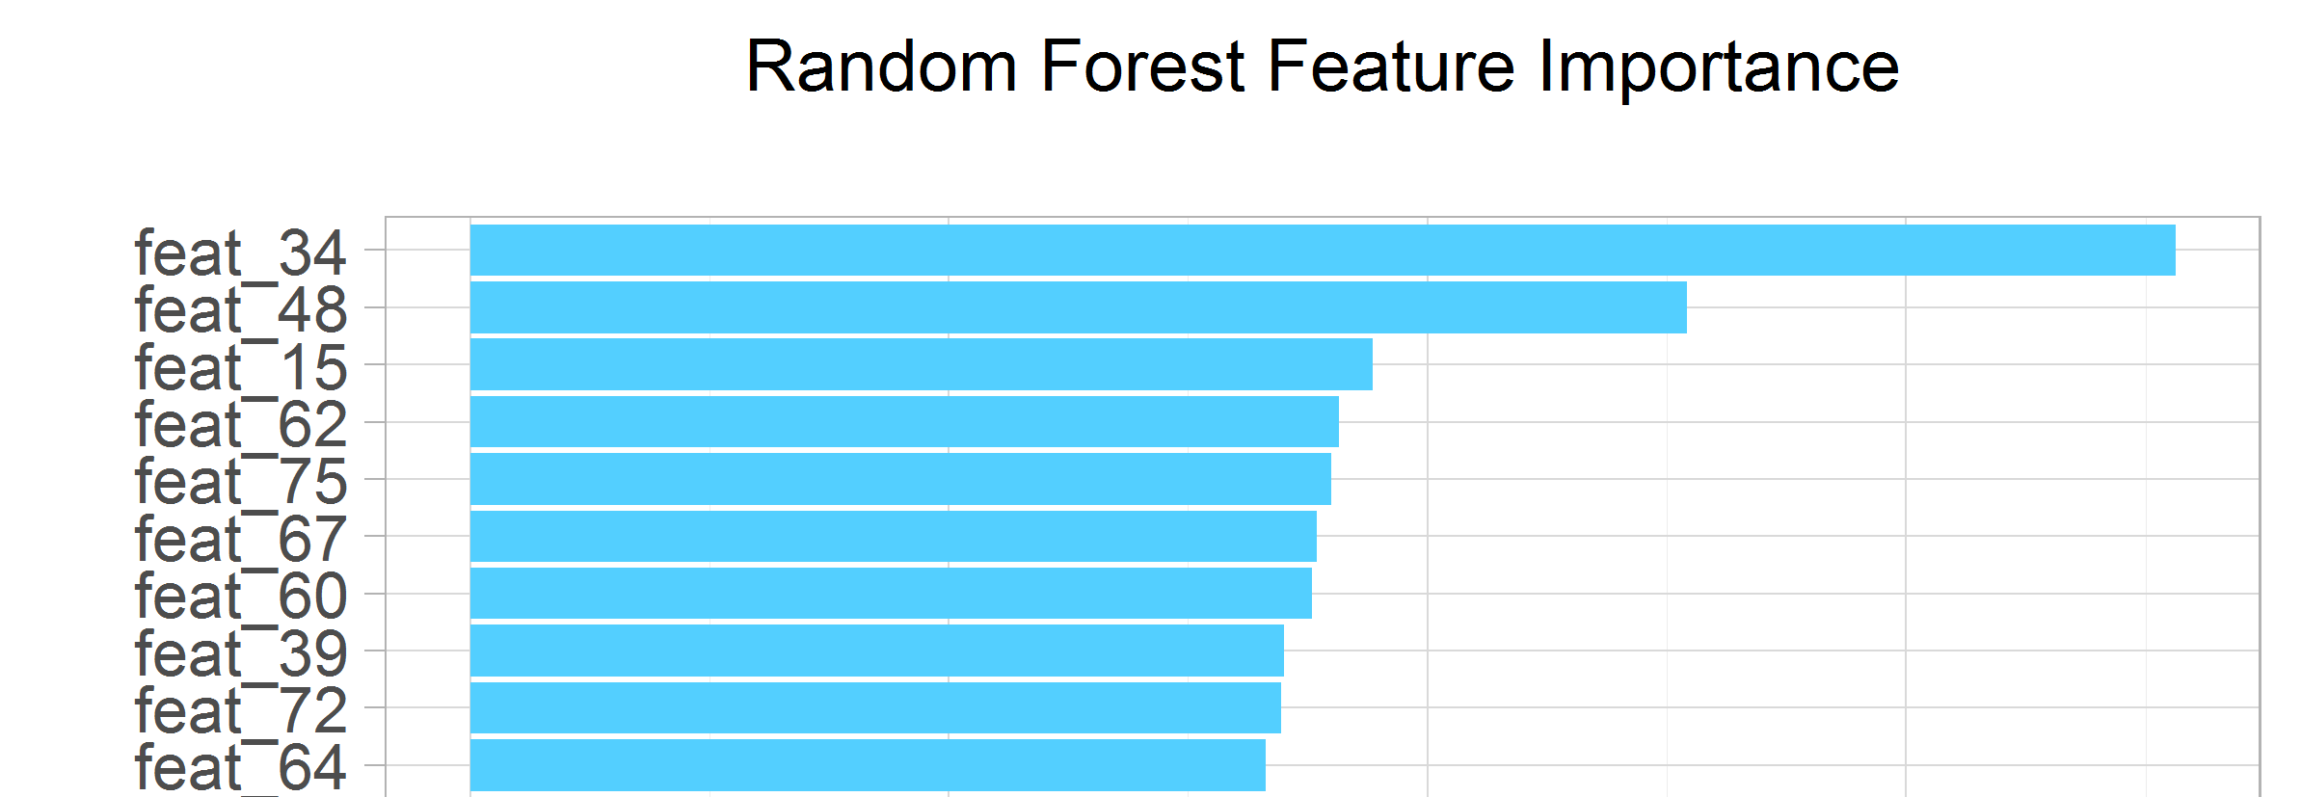
Random Forest Algorithm
Fig.3 Random Forest Accuracy Weka vs R
Accuracy was highest when the number of trees set was 50
Fig.4 Top 10 Important Features
Notes:
One of the widely used algorithms for classification is Random Forest.
Each tree is trained on roughly 2/3rd of the total training data (exactly 63.2%) .
For each tree, using the leftover (36.8%) data, calculate the misclassification rate - out of bag (OOB) error rate. Aggregate error from all trees to determine overall OOB error rate for the classification.
Each tree gives a classification, and we say the tree "votes" for that class. The forest chooses the classification having the most votes over all the trees in the forest.

Slide 12
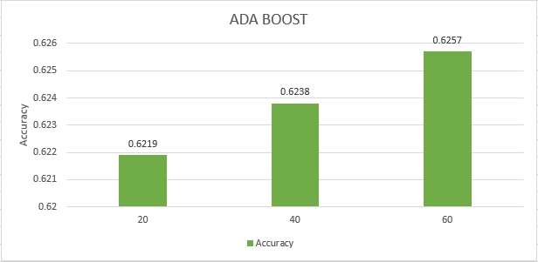
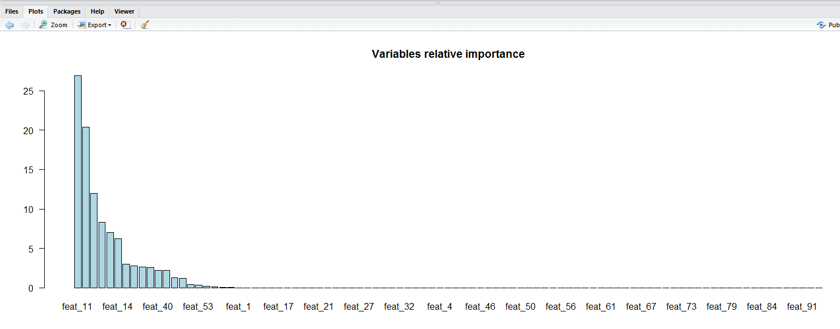
ADA BOOST algorithm
Fig.5 ADA Boost Accuracy
Accuracy was highest when the number of trees set was 50
Fig.6 Top 10 Important Features

Slide 13
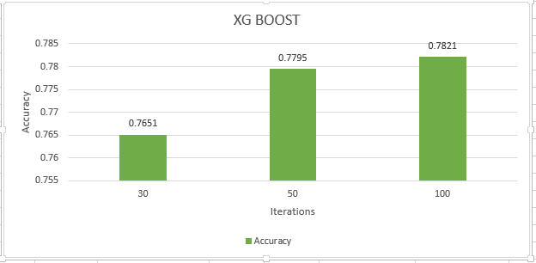
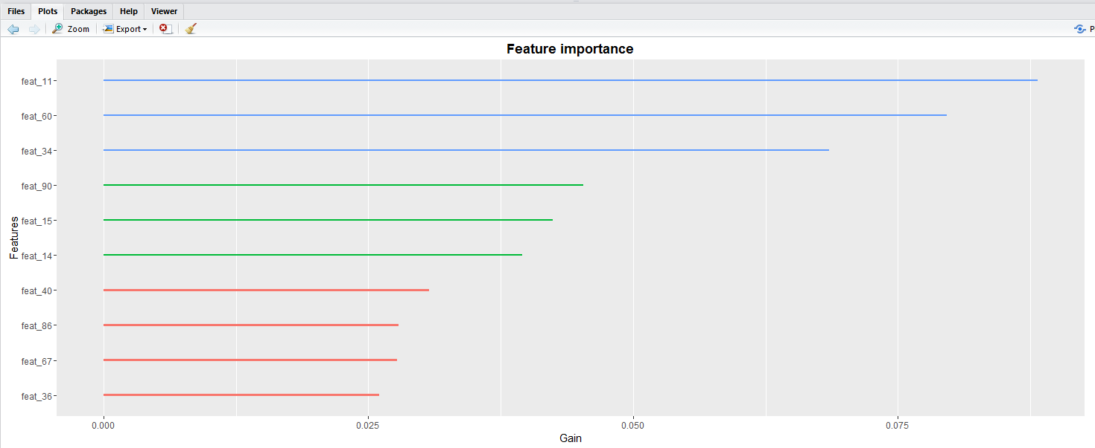
XG BOOST ALGORITHM
Fig.7 XG Boost Accuracy
Accuracy was highest when the number of trees set was 50
Fig.8 Top 10 Important Features

Slide 14
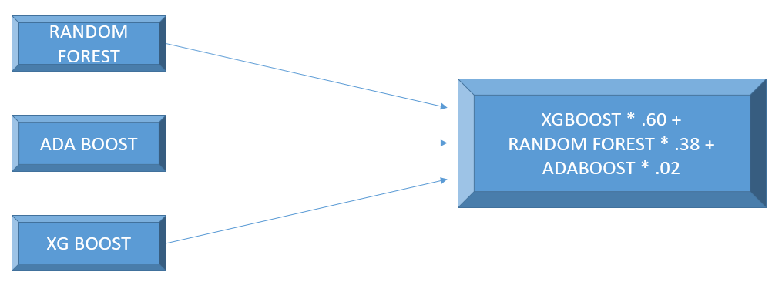
Ensemble model
Fig.9 Ensemble Model
Does not depend on feature normalization
Learn Higher order interaction between features
Easy to scale
Achieved classification accuracy of 80.7%

Slide 15
Conclusion
Tree Based Algorithms Random Forest and XG Boost had the best classification accuracy
Each algorithm predicted its own set of important features
Feature Reduction did not have significant effect on accuracy
The ensemble model improved accuracy
By adding more models to the ensemble model accuracy can be improved further

